Slide 1
Smart Waste Management System
PUSL2008 Introduction to Internet of Things
IOT Assignment
Group - 67

Slide 2
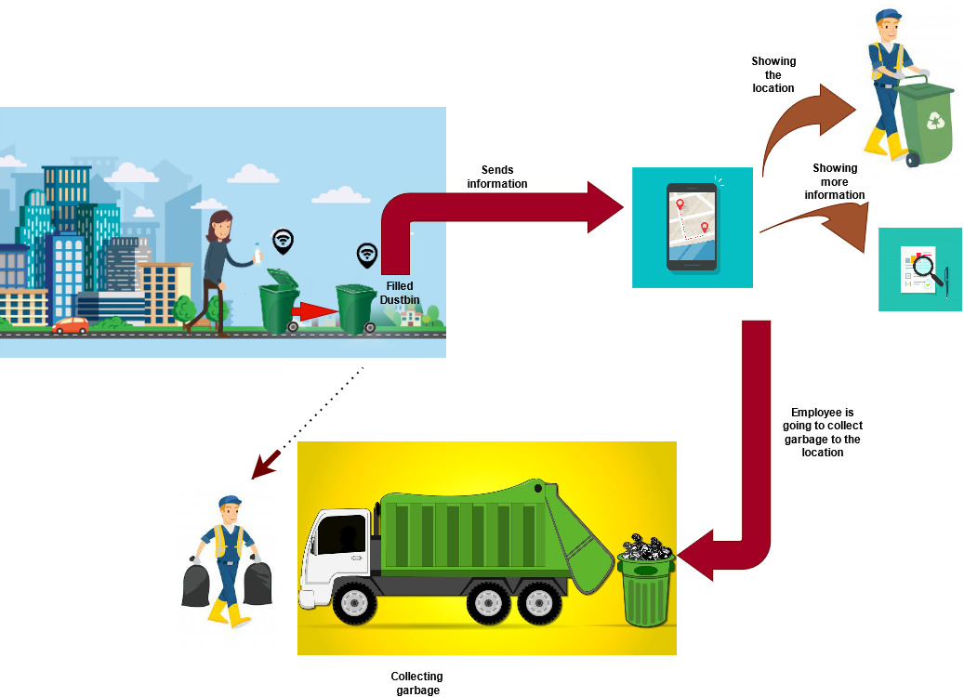

Slide 3

Objectives
To develop cities according to smart city concept by making the city tidy.
To measure the level of the garbage inside dustbins to avoid overflowing.
To stop mixing of all types of waste at waste collecting places.
To save time of all the people in cities by opening the dustbin when come near to the dustbin.
To increase the efficiency of employees by taking the quick notification with the correct location.
To stop the missing of taking garbage from different locations by the GPS system with applications.

Slide 4
Background and Motivation
We have found three main issues in current system.
There has no way to know whether the dustbins were filled or not.
There has no way to identify what are inside really in the dustbins with amounts and more information.
There has no way to track the locations of where the filed dustbins are located.

Slide 5
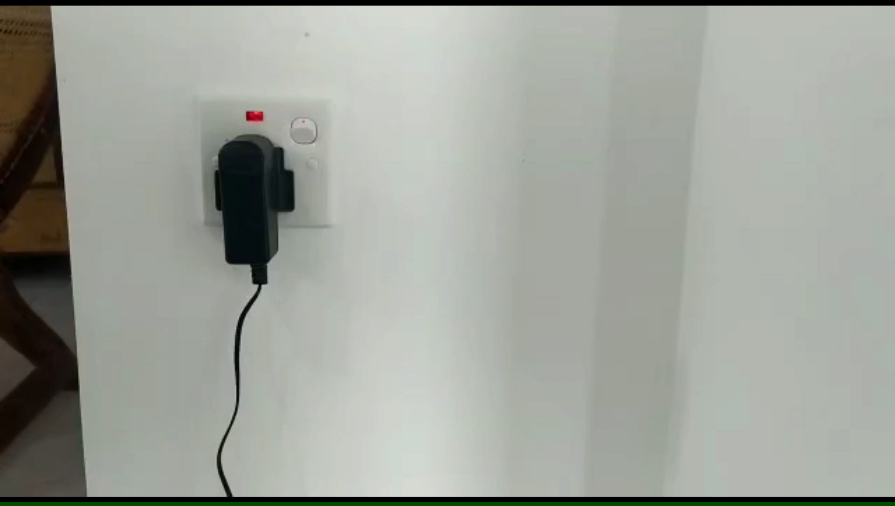

Slide 6
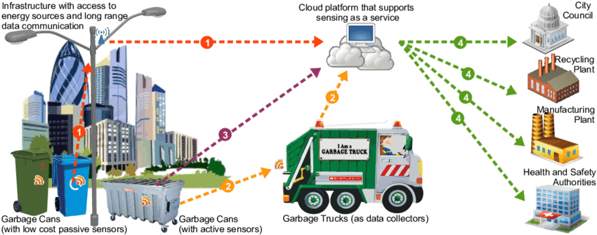
Proposed system
Giving a notification to the garbage collector to inform the dustbins were filled by the mobile app.
Giving the humidity level of the filled garbage, total amount of garbage in a dustbin and an each unique dustbin number by the web app and mobile app.
Showing the locations of the filled dustbins in a map by web and mobile apps.

Slide 7
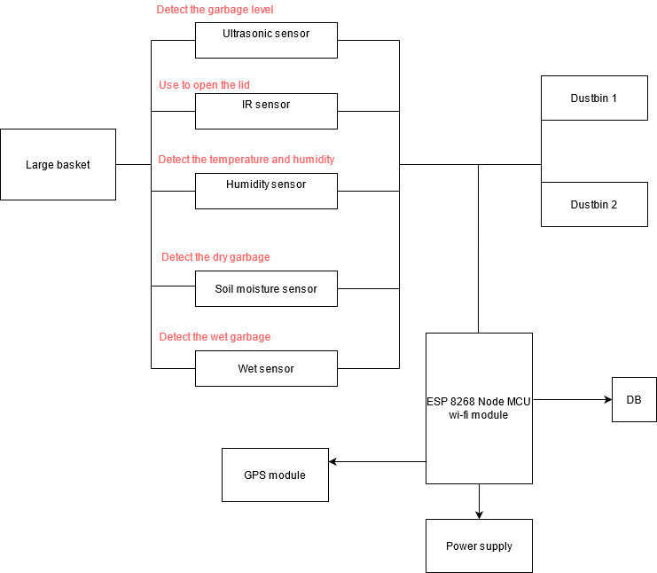
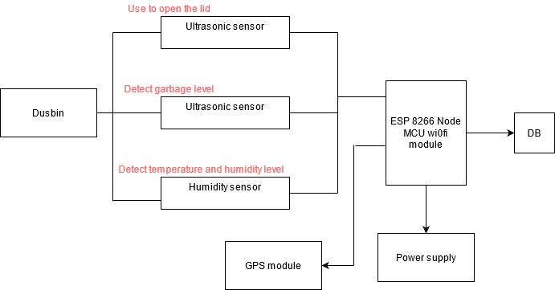
Proposed system
Current system

Slide 8
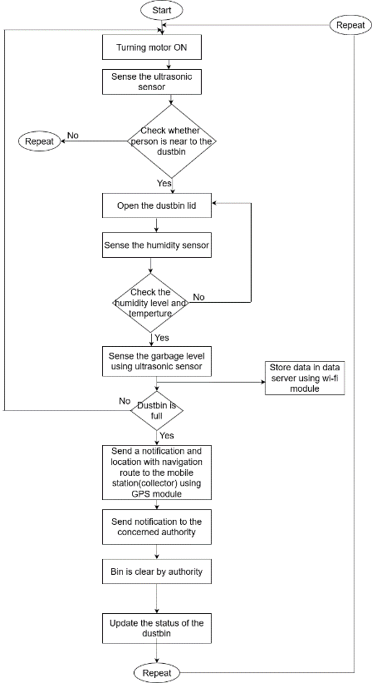

Slide 9
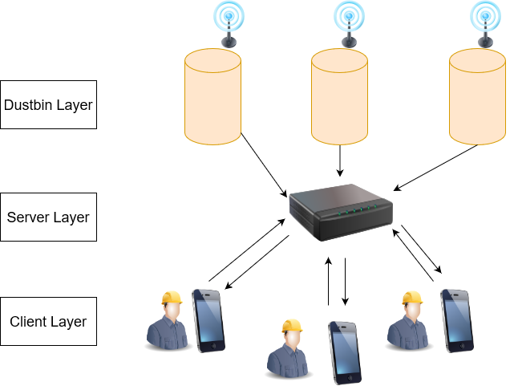
System Architecture

Slide 10
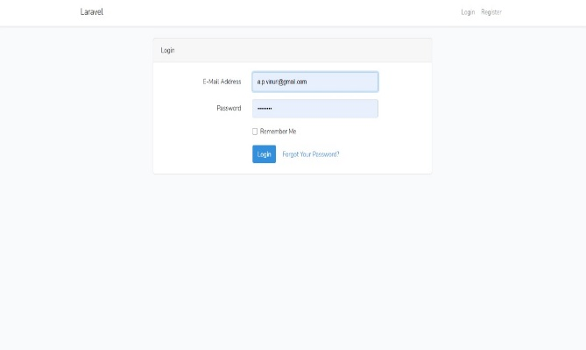
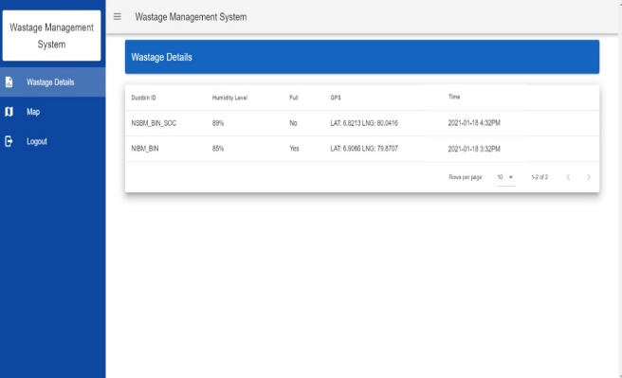
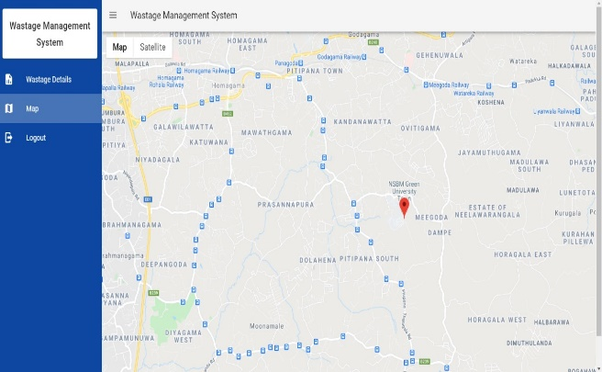
Web Based Development
Two end points
Database humidity level/ total number of garbage/ unique No of each dustbin)
Filled status
Location of filled dustbins
Laravel framework
Front end- VueJs, Vuetify
Back end-Laravel (PHP)
Database-MariaDB/MySQL
Graphics/UI design-Adobe XD

Slide 11
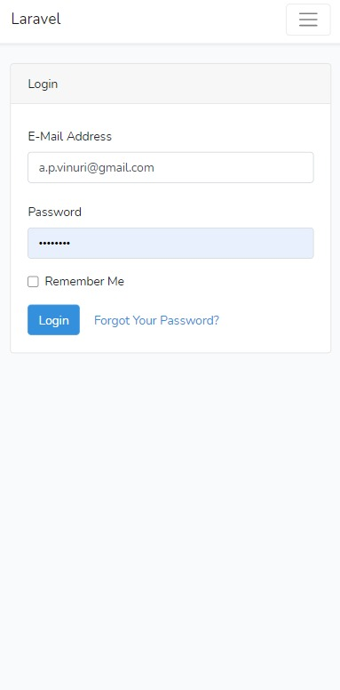
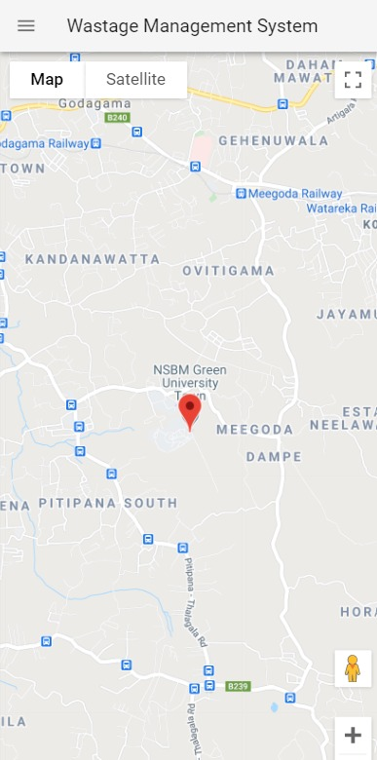
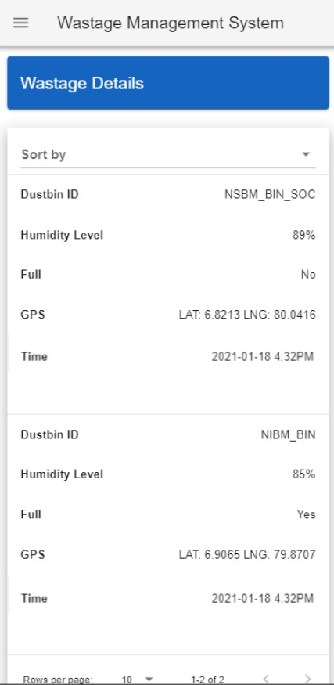
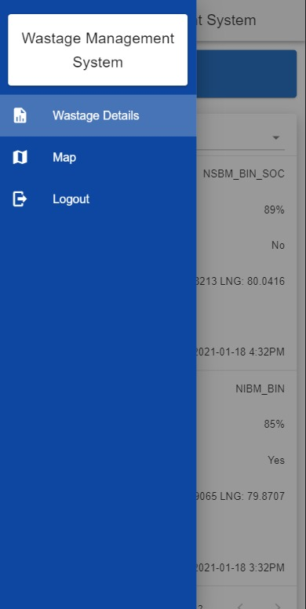
Mobile Application Development
Android app
Notification with the location
Use by dustbin collectors and staff
Front end - Flutter framework
Back end- Flutter framework
Database - Firebase
Graphics/UI design-Adobe XD/Figma

Slide 12
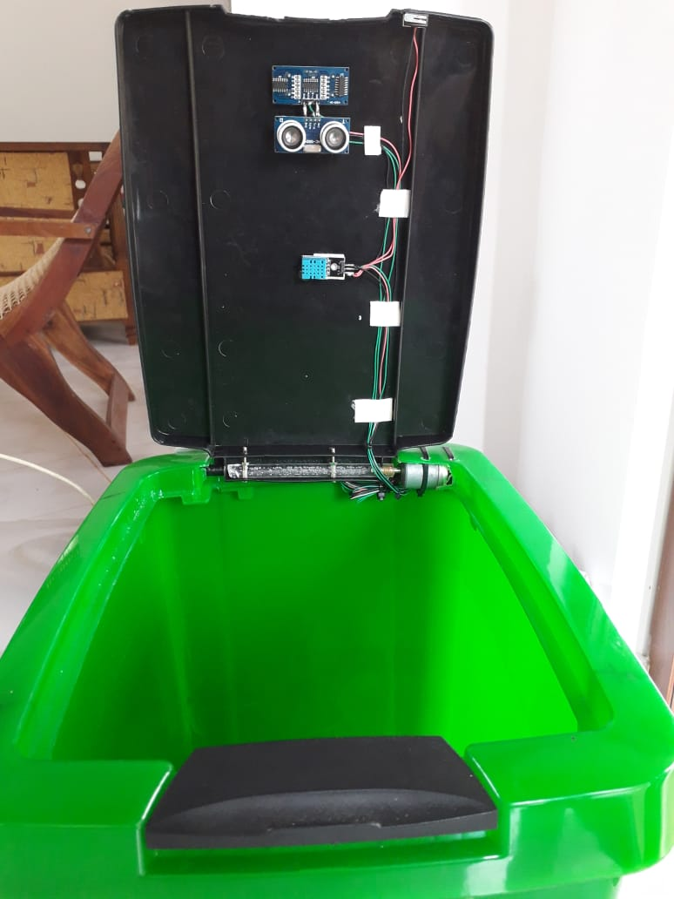
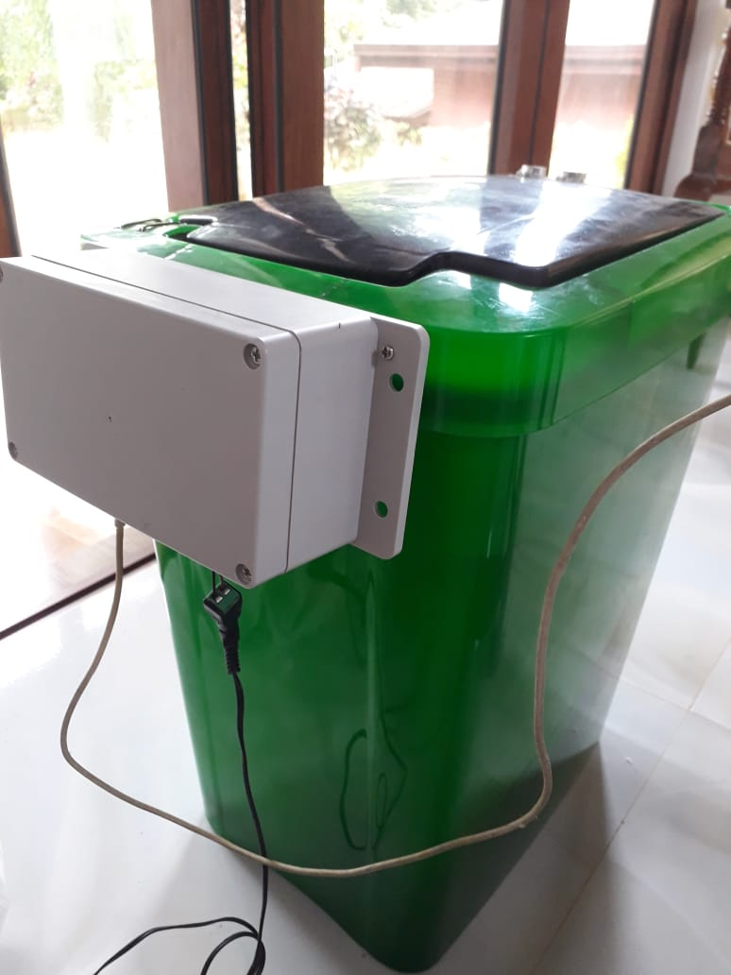
Hardware Development
Ultrasonic Sensors-:
To determine the filled amount of the dustbins
To open the lid of the dustbin after the collector came
DHT11 Temperature and Humidity sensor -:
To detect humidity level of the dustbins
Node MCU ESP8266 - Wi-Fi – board module-: Make connection and process the data.
12V power supply-: The power supply we are using 3.7V for the system. AMS 1117 5V to 3.3V DC-Step-Down power supply module use to convert 12V to 3.7V.
DC-step- down power supply module

Slide 13
Future Implementation
Adding more dustbins to the system.
To locate all the dustbins (filled dustbins and other non filled dustbins).
Come up with a communication system for garbage collectors and cleaners to connect each other.
Alert message system for the nearest garbage collectors.
Adding more details of the employees as working hours to calculate their salaries for making more easier to their companies.

